Slide 1
Human eye
done by :
*safeya Mohammed
*fatima salem
12.52

Slide 2
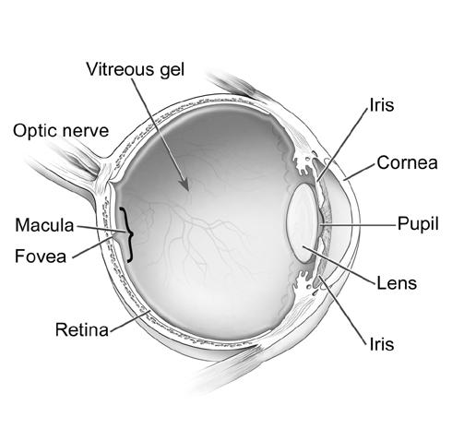
how does human eye works?
Human eye works similar to camera ,each part in the human eye plays in a vital role to provide clear vision. So, we can say that human eye acts as a camera. The eye has a lens, and a sensitive light tissue at the rear of the eye called retina which acts as the photographic film.

Slide 3
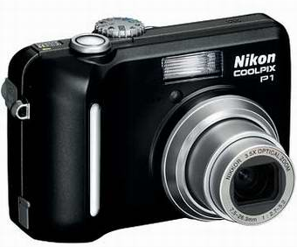
In camera when we want to see the things clearly we press on zoom ,so that we can make the image bigger or smaller , the same way in human eye happens. The cornea is a structure found in front of the eye that helps to focus incoming light , we have something behind the cornea called iris, (which is a colored ring shaped membrane) and inside the iris there is a circular opening called the pupil which can stretch or compress depending on the amount of light entering the eye. At the rear of the eye the retina will be found.

Slide 4
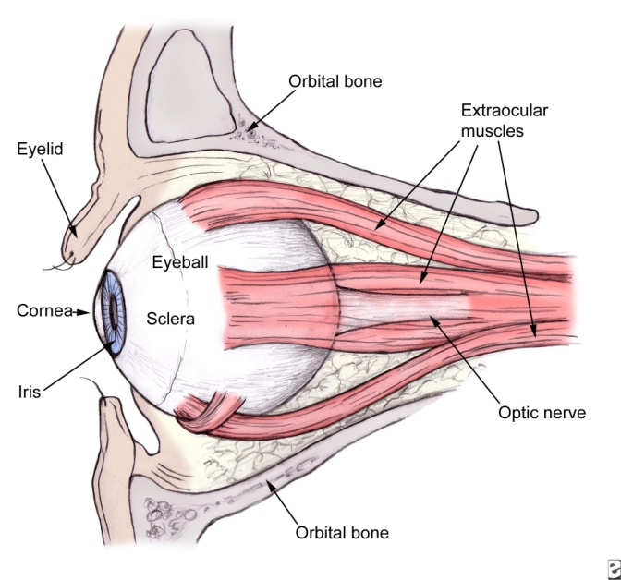
we have many important parts in our eyes supporting role in the main activity of sight such as : muscles that allow eye to move , carry fluid like (tears and blood ) and so on .
The muscles inside the eyes are important because they are holding lens in their places .when the muscles relax ,they pull on and flatten the lens to allow the eyes to see the far objects , moreover to see the closer objects the muscles must contract .

Slide 5
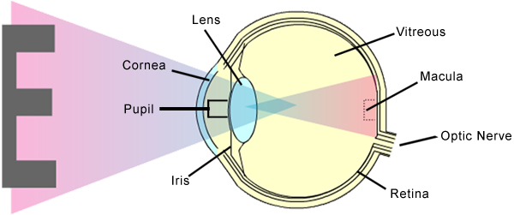
When light enters the eye it will fall on the retina which is light sensitive forming the object image. Certain processes will occur to transform the image to the brain so that we will be able to see objects.

Slide 6
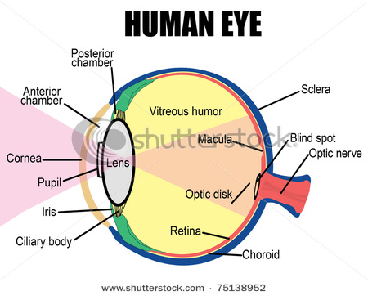

Slide 7
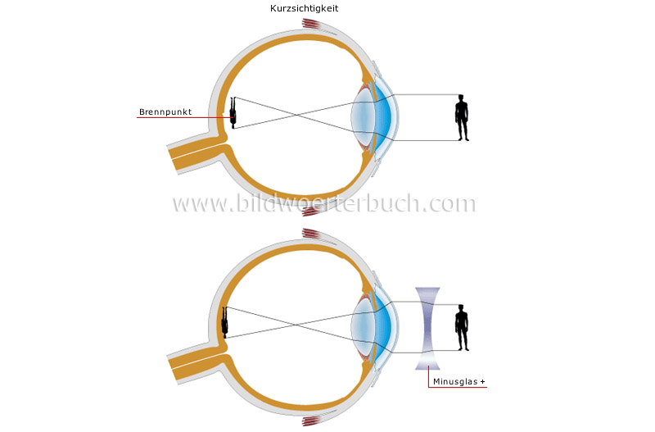
vision defects
There are lots of vision defects that people are suffering from. These defects include Nearsightedness, Farsightedness and Astigmatism. You will be familiar with these eye defects after reading the following explanation.

Slide 8
1-Nearsightedness:
Another name for Nearsightedness is myopia. This type of vision effects means that it is easy for the person to see close objects to him but difficult to see far objects. The image of the far object may look fuzzy. People with high Nearsightedness can see only the very close objects to them like their hands for example. But people with mid Nearsightedness can see objects further by yards.
It happens when the eye ball has an oval shape instead of round. This makes the light rays entering the eye to focus far away in front of the retina instead of falling on it which will cause seeing from a distance a real problem.

Slide 9
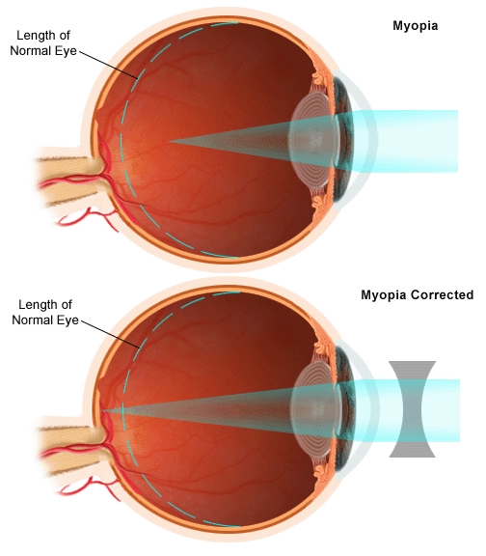

Slide 10
2-Farsightedness :
Farsightedness is also called hyperopia. This eye defects will make people able to see distance objects but unable to see close objects. Farsightedness occur when the eye is very short. The shorten of the eye will cause the light rays entering the eye to fall behind the retina instead of falling on the retina.

Slide 11
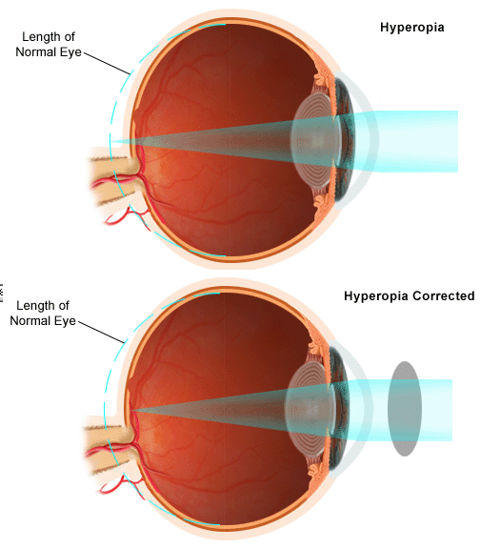

Slide 12
3- Astigmatism
Astigmatism causes vision to be blurred or distorted to some degree at all distances. It is caused by the irregularly shaped cornea or lens. The cornea must be symmetrically round shaped for a normal vision. But people with Astigmatism problem has unevenness cornea or lens parts.

Slide 14
Eye defects corrections
Eye defects can be corrected by using eyeglasses or contact lenses. Another way is by surgery. Most people prefers to use eyeglasses and contact lenses rather than surgery.
Farsightedness correction:
Farsightedness can be corrected by using a concave(diverging) lens. A concave lens of appropriate power of focal length is able to bring the image of the object back on the retina.

Slide 15
Nearsightedness correction:
Nearsightedness can be corrected by using a convex (converging) lens of appropriate focal length. Eyeglasses with converging lenses provides the additional focusing power required for forming the image on the retina.
Astigmatism correction:
Astigmatism can be corrected by using eyeglasses with cylindrical lenses oriented to make the eye lens and cornea with equivalent smooth parts.

Slide 16
Resources:
http://www.mayoclinic.com/health/nearsightedness/DS00528
http://www.bausch.com/en/Eye-concerns/Vision-Correction/Nearsightedness
http://www.allaboutvision.com/conditions/astigmatism.htm
http://cbsescience.wordpress.com/2007/01/02/defects-of-vision-and-their-correction/

